Slide 1

CSCI910/410
Software Requirements, Specifications and Formal Methods
Week6 Tutorial

Slide 2

Exercise 1
1. Analyse the background information and three modules and specify the potential stakeholders, the domain requirements, and the functional and non-functional requirements of the project.

Slide 3
Stakeholders
Patients: Patients are the primary stakeholders in the system. They will use the system to register their personal information, get medical treatment, and receive medication.
Doctors: Doctors will use the system to diagnose patients, prescribe medication, and update the patient's medical record.
Nurses: Nurses will use the system to record patient information, deliver medication, and update the medication delivery record.
Hospital Management: Hospital management will use the system to manage patient data, monitor the hospital's performance, and allocate resources efficiently.
Government Agencies: Government agencies may use the system to monitor the hospital's compliance with regulations, collect statistics, and facilitate public health policies.

Slide 4
Domain Requirements
The system must ensure accurate medicine delivery, with appropriate dosages and timings.
The system must be available 24/7 to support emergency care.
The system must store patient information securely and confidentially.

Slide 5
Functional Requirements
Nurse: check patient's information (e.g., personal info, medical record, prescription), record/update personal info and medicine delivery record, submit diagnosis results.
Doctor: check, update patient's information (e.g., personal info, medical record, diagnosis results), submit prescription.
System: mechanisms for doctor assignment, display patients based on which nurse cares them.

Slide 6
Non-Functional Requirements
The system should be user-friendly and easy to use, e.g., how long does it take for nurses to learn to use the system.
The system should be compatible with different devices and browsers.
The system should be able to handle concurrent users.

Slide 7
Exercise 2
Draw a level-0 Data Flow Diagram for the project.

Slide 8
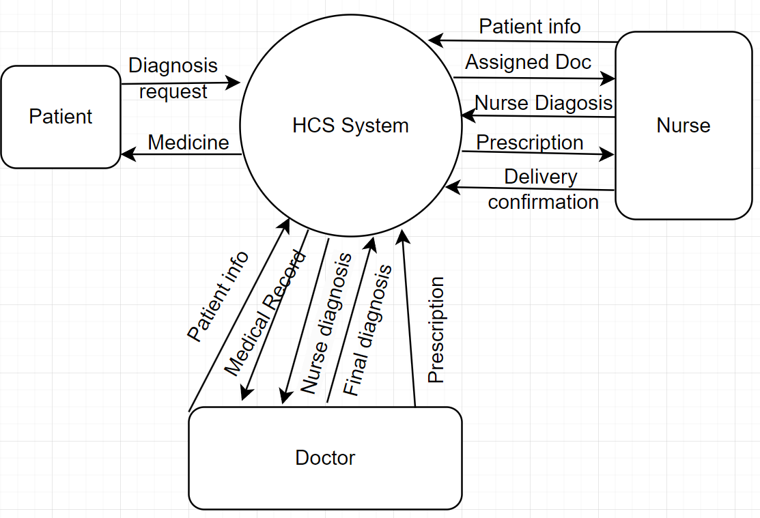
Level 0 Context Level DFD

Slide 9
THANKS

